Slide 1


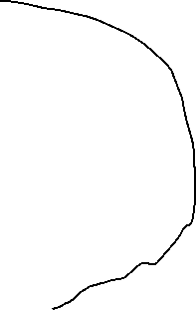
No Local Variables
Moon
arg2
•
8 bytes
arg1
•
₀
ref
•
arr[2]
1601
₀
AR Main
arr[1]
1100
12 bytes
arr[0]
1501
No Arg

Slide 2
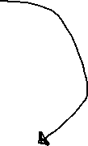
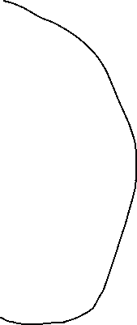
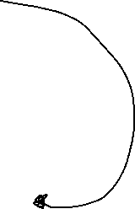

No Local Variables
Jupiter
x
•
No Local Variables
Mars
arg2
•
arg1
•
1400
p
₀
•
8 byes
₀
ref
•
arr[2]
1602
₀
AR Main
arr[1]
1100
12 bytes
arr[0]
1700
No Arg

Slide 3
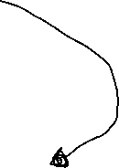
setRealPart
arg
666
this
•
num1
imag
?
8 bytes
real
666
8 bytes
AR Main
No Arg

Slide 4
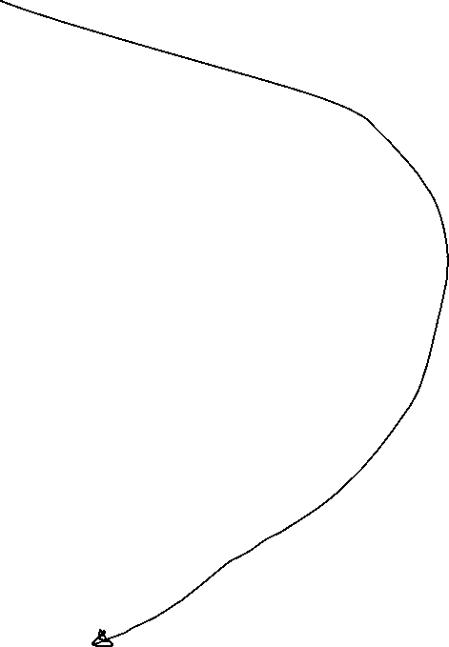
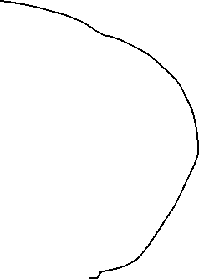
No Local Variables
getRealPart
this
•
No Local Variables
AR global print
n
•
imag
?
₀
8 bytes
num1
real
666
8 bytes
AR Main
No Arg

Slide 5
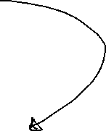
imag
5
CPLX
real
34
this
•
num2
imag
?
8 bytes
real
?
8 bytes
num1
imag
5
8 bytes
real
700
8 bytes
AR Main
No Arg

